Slide 1

Engine Breakdown Risk Assessment
June 5, 2026

Slide 2
Contents
1. Backend design
2. Analysis
3. Next steps

Slide 3
1. backend design
Engine operation records
50 engines, 10 operations each
Variables
Operating hours
Piston material
Past damage
Etc.
Goal
Data cleaning (e.g. handling null values, extreme values, etc.)
Establishing data model

Slide 4
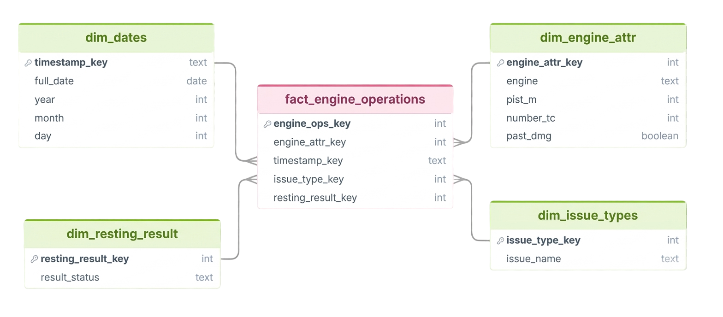
1. backend design
Fact table
Keys and numerical variables (oph, np_img, etc.)
Dimensions
Date table
Resting analysis results
Engine attributes
Physical characteristics of the engines (e.g. piston material) or other engine-specific attribute (past damage)
Combustion issue types

Slide 5
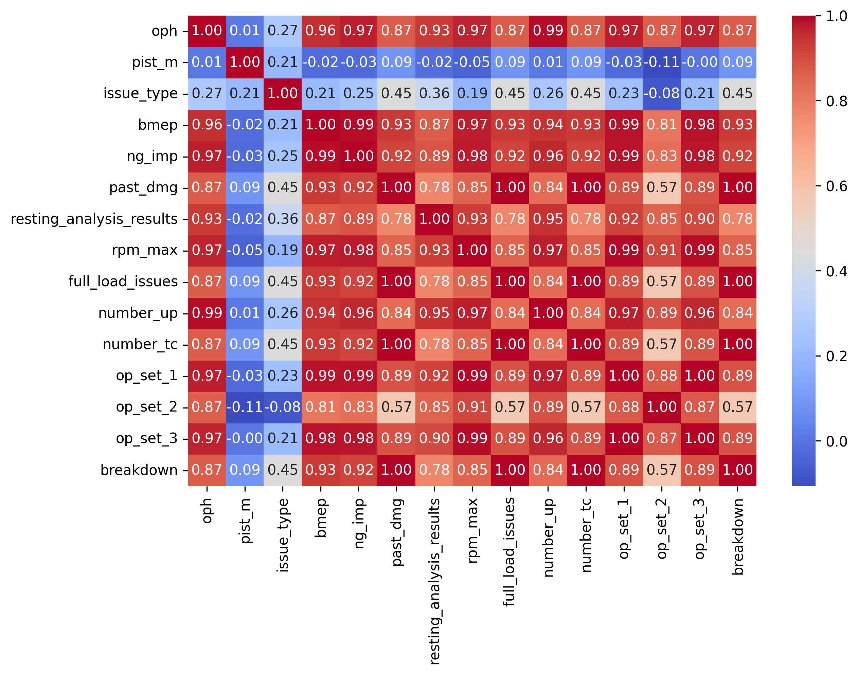
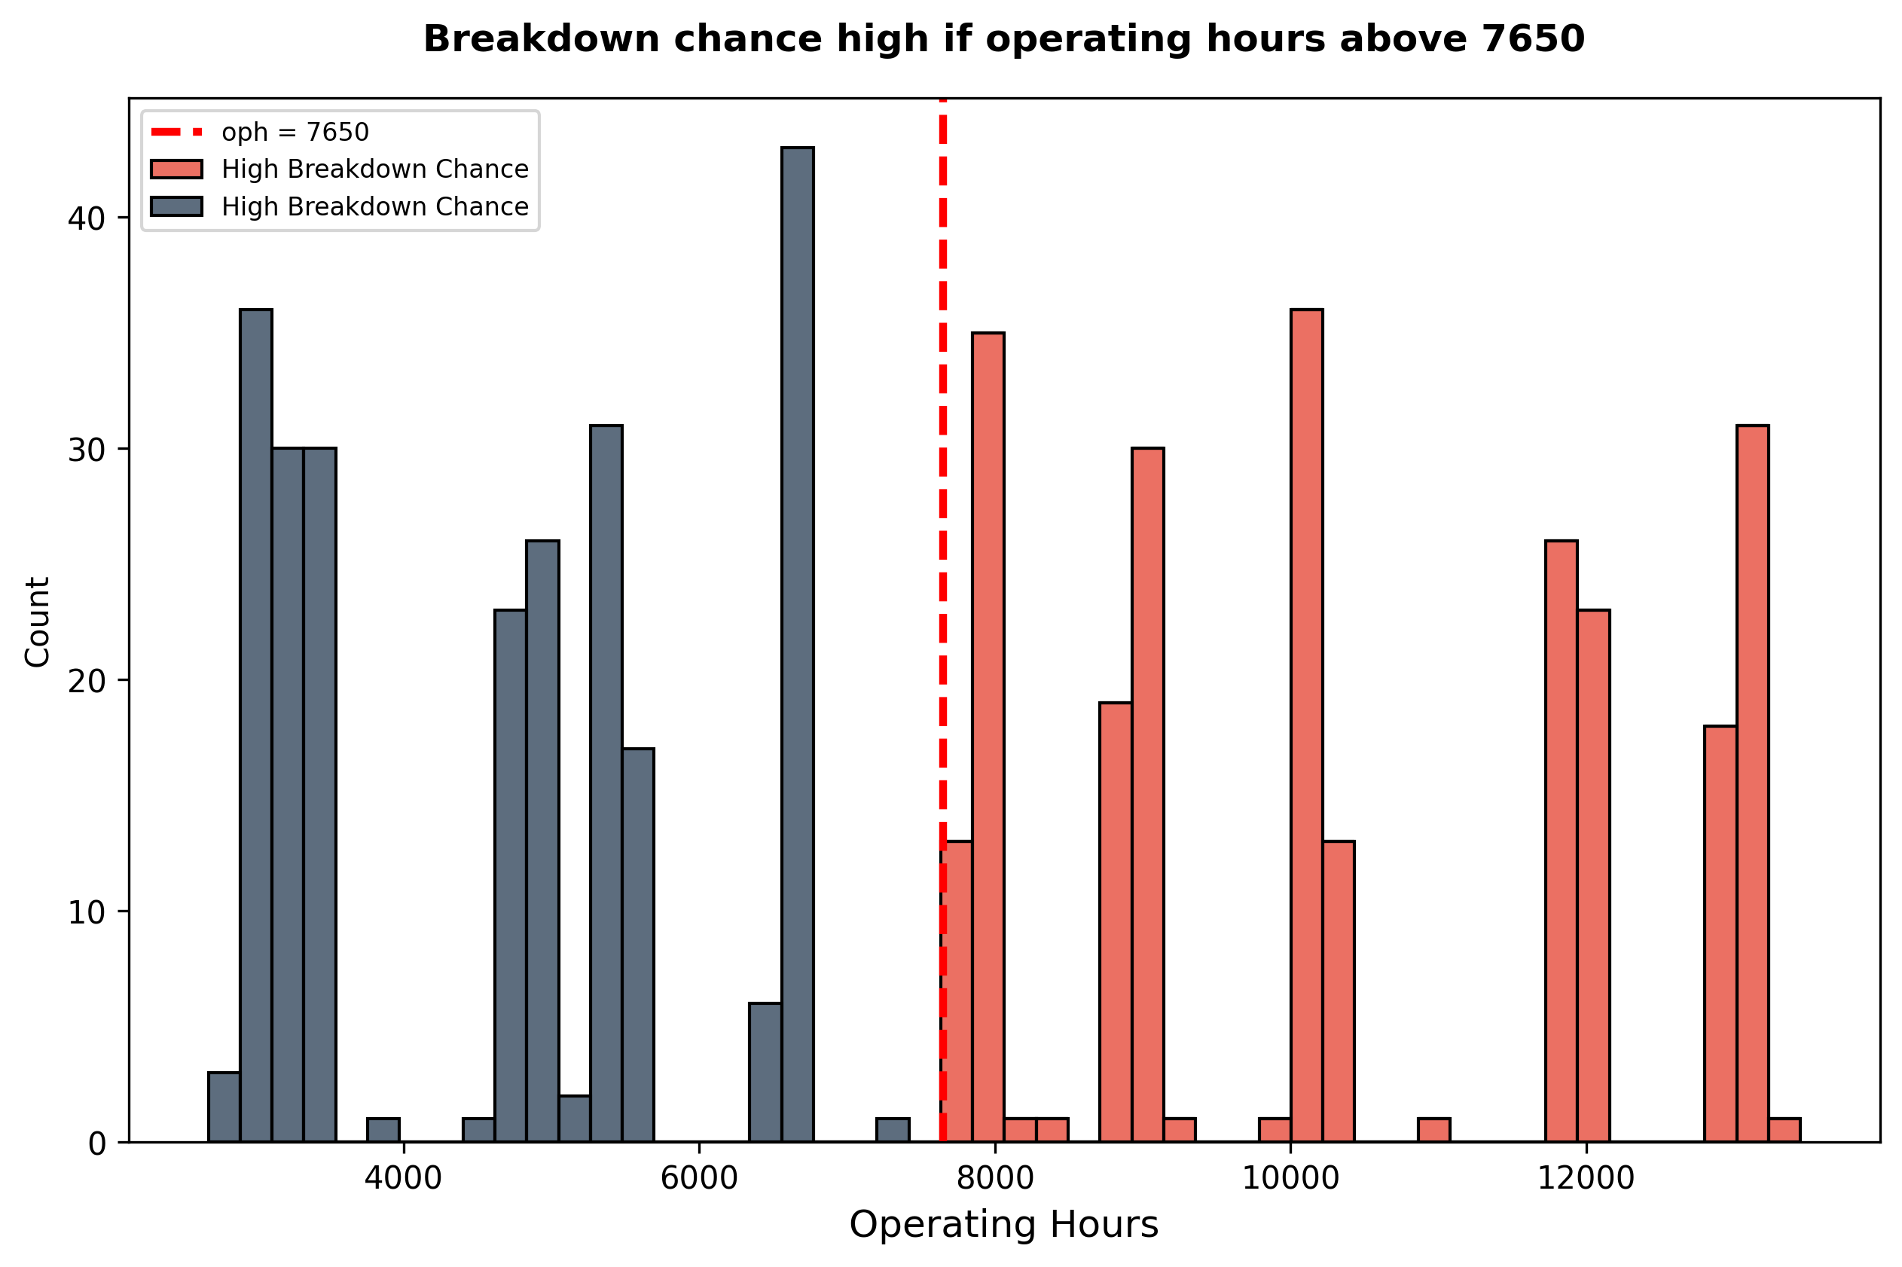
2. analysis
Exploratory Data Analysis
Synthetic Data
Correlation matrix
Multicollinearity
Related variables e.g. measuring the same latent variable
Problem for predictive model input
Critical values perfectly divide the dataset to low and high breakdown chance
operating hours = 7650
rpm_max = 1495

Slide 6
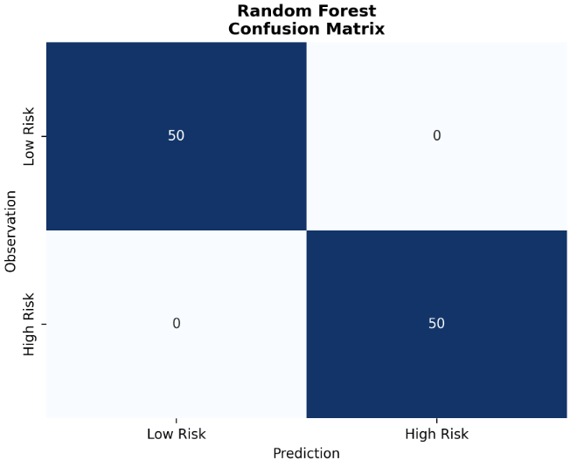
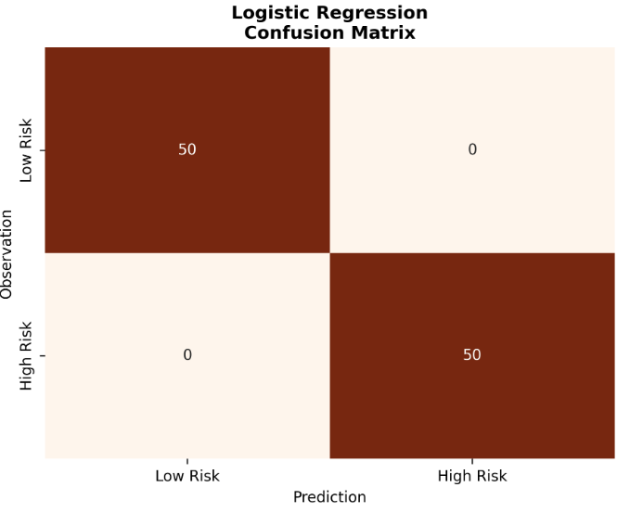
2. analysis
Predictive approach
Dataset is not appropriate to be an input for ML models
Predictor variables being perfectly in line with target variable
e.g. if past_dmg = 1, breakdown = 1 for every case
Result is overfitting
The model learns the dataset, not the underlying patterns, leads to inaccurate prediction results
In real life usecases…
Logistic regression, Random Forest

Slide 7
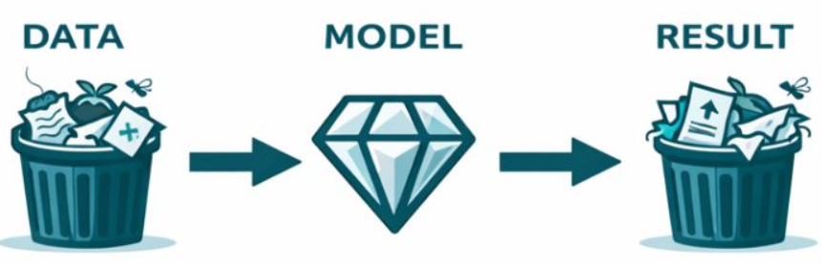
3. next steps
Solid backend foundation and pipeline
Predictive framework to be perfected
Main takeaway
Data quality is a prerequisite for proper results
Further data collection for more variables, lower level of granularity

Slide 8
Thank you!

